Slide 1

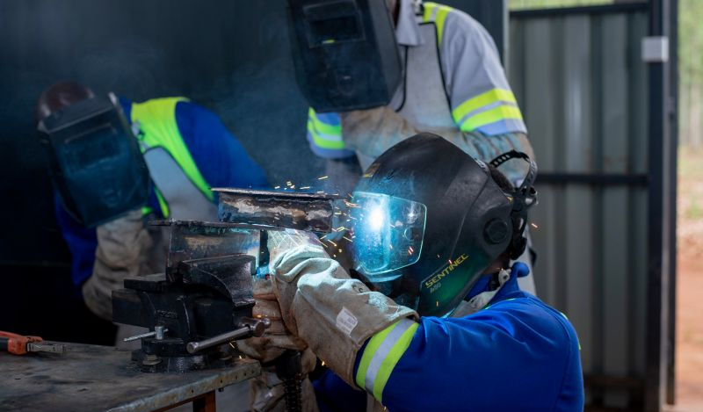

VIRTUAL REALITY
WELDING TRAINING
CODED WELDER: OFO 651202-02
KM-03: WELDING CODES, STANDARDS AND PARAMETERS, NQF LEVEL 04, CREDITS 2

Slide 2

ABOUT THIS MODULE
The focus of the learning in this knowledge module is to build an understanding of welding codes, standards and parameters as applied in the welding trade.
The learning will enable learners to demonstrate an understanding of:
KM-03-KT01: Codes and standards for welding (40%).
KM-03-KT02: Concepts related to welding parameters (60%)

Slide 3
KT01: Codes and standards for welding
Welding codes and standards are essential for ensuring the quality, safety, and consistency of welding processes and products.
They are used both nationally and internationally to regulate various aspects of welding
Welding standards, often referred to as welding codes, are essential guidelines that ensure the quality, safety, and consistency of welding processes.
Different countries have their own organizations responsible for developing and maintaining welding codes.

Slide 4
The different codes and standards internationally adopted. - These codes and standards, collectively ensure that welding processes meet rigorous safety, efficiency, and quality standards. Their implementation benefits various industries and fosters global welding consistency.
United States of America – ASME (American System for Mechanical Engineering) they also have an independent standards organization which oversees all welding codes and standards called the AWS (American Welding Society)
Europe – ISO (International Standards Organisation) and the IIW (International In statute of Welding)
Germany – DIN (Deutsche International Norme)

Slide 5
There are three major international standards organizations. These organizations collectively establish the World Standards. This includes:
International Organization for Standardization
International Telecommunication Union
International Electrotechnical Commission

Slide 6
In South Africa, we follow standards made by a group called the South African Bureau of Standards (SABS), which are based on ISO.
Standards are comprehensive documents agreed upon by experts from various countries and approved by globally recognized bodies.
Standards make sure that things are the same no matter where you are in the world.

Slide 7
Standards for welding equipment and welding consumables, practices and product standards that contain welding requirements
Standards for welding are essential for ensuring the quality, safety, and performance of welding processes.
They provide guidelines and requirements for welding procedures, equipment, materials, and inspection to meet industry-specific needs and standards compliance.
Different organizations/ counties have different guidelines depending on the adopted. Some of the common organizations include:
* The American Society of Mechanical Engineers (ASME)
*American Welding Society (AWS)
*British Standards (BS)
*International Organization for Standardization (ISO)

Slide 8
The American Society of Mechanical Engineers (ASME)
Develops codes and standards for mechanical engineering, covering various industries such as manufacturing, energy, and construction.
American Welding Society (AWS)
Sets standards for welding and allied processes in the United States, ensuring safe and effective welding practices.
International Organization for Standardization (ISO)
A global organization that creates international standards for various industries and sectors to promote consistency and quality on a global scale.
British Standards (BS)
Developed by BSI, includes standards and specifications for a wide range of products and services in the United Kingdom.

Slide 9
Some of the common welding standards from the international organizations
Welding Equipment Standards:
Welding Consumables Standards
Ensure safety in welding equipment design and manufacturing.
Specify performance criteria for power output, duty cycle, and reliability.
Emphasize compatibility with specific welding processes.
Provide maintenance and inspection guidelines.
Include markings for compliance identification.
Define composition and properties of electrodes, filler metals, gases, and fluxes.
Enforce strict quality control measures.
Ensure compatibility with welding processes and materials.
Recommend proper storage and handling.
May guide Welding Procedure Specifications (WPS).
Certified and marked consumables meet quality and performance standards.
Address welding flux and shielding gas quality.

Slide 10
Welding Abbreviations, terminology, and definitions
Welding is a complex field with its own set of abbreviations, terminology, and definitions.
It is a critical process in various industries, including construction, automotive, aerospace, shipbuilding, energy production, and manufacturing.
Understanding the different abbreviation, terminology and definitions assist with understanding the scope of work.
(students to receive a list of welding terminologies)

Slide 11
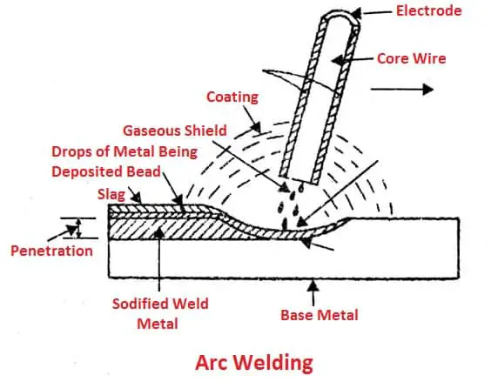
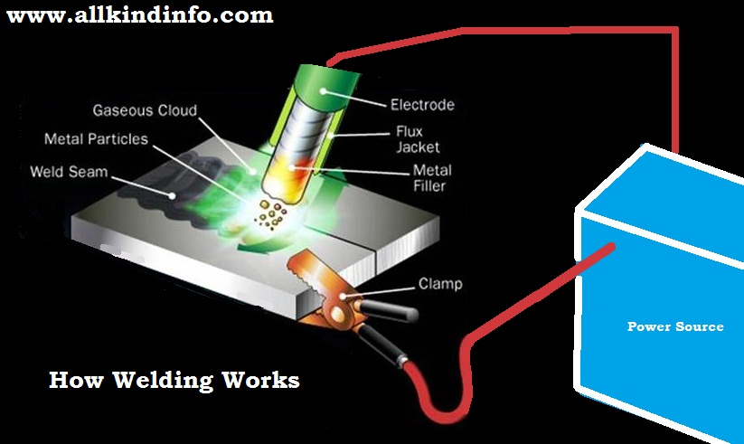
Assessment activity 1. Define and elaborate on the scope of work required from these images.

Slide 12
Concepts related to welding parameters
1. Welding Procedure Specifications
A Welding Procedure Specification (WPS) is a formal document that guides welders in creating quality welds according to code requirements.
Each material alloy and welding type has its own WPS.
A Procedure Qualification Record (PQR or WPQR) validates the WPS through rigorous testing.
Welders are certified through a Welder Qualification Test Record (WQTR) to ensure they can work within the specified WPS.

Slide 13
Components of a welding procedure
Parent Material
Welding Process
Welding Consumables
Joint Design
Welding Position
Thermal Heat Treatments
Testing
Material Type
Thickness
Diameter (for Pipes)
Surface Condition
Type of Process (e.g., MMA, MAG, TIG, SAW)
Equipment Parameters (Amps, Volts, Travel Speed)
Type and Diameter of Consumables
Brand/Classification
Handling and Storage Guidelines
Edge Preparation
Root Gap and Root Face
Jigging and Tacking
Baking Requirements
Location (Shop or Site)
Specific Welding Position (e.g., 1G, 2G, 3G)
Weather-Related Precautions
Preheat Temperature
Post-Weld Heat Treatments (e.g., Stress Relieving)
Tests for Required Properties
Tests for Weld Quality

Slide 14
Key notes
Approved welding procedures meet standards including essential variables.
The South African Institute of Welding (SAIW) uses a database for approval.
Mixing different codes is not allowed and qualification heat treatment must match production.
Accredited labs with oversight conduct tests.
Weld proximity follows safety standards.
Welders must meet code qualifications.
Petrochemical industry requires specific welding procedures.
Welding Procedure Data Sheet (WPDS) specifies parameters.
Proper WPDS completion is crucial, and errors are highlighted.

Slide 15
Welding parameters, welding positions
The quality of the weld and the amount of metal deposited in the weld are both affected by a range parameters.
These parameters include the welding current, arc voltage, welding speed, electrode feed rate, electrode extension, electrode size, electrode alignment, electrode polarity, and the composition of the shielding gas.

Slide 16
The 5 key parameters of welding
Weld quality and the amount of deposited metal in a weld depend on key welding (CLAMS) factors:
Current: Amperage affects bead size and depth.
Arc Length: Distance between electrode tip and weld puddle controls heat.
Angle: Work and travel angles impact heat distribution.
Manipulation: Hand movements guide electrode for proper penetration.
Speed: Adjusting welding speed ensures desired bead size and penetration.

Slide 17
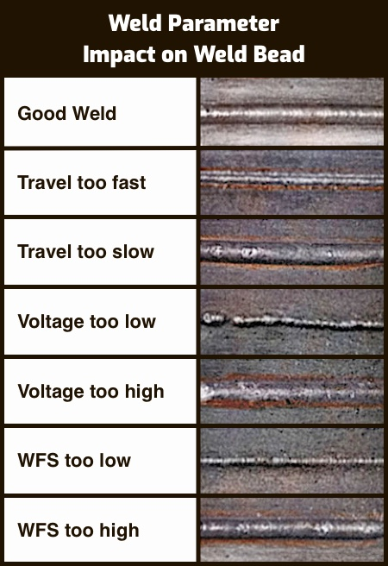
The following chart shows how some CLAMS variables impact a weld bead:

Slide 18
Other parameters which could affect the quality of weld
Size: Base metal thickness affects welding choices. It is a primary consideration.
Heat Control: Metals disperse heat differently, requires monitoring heat is vital for preserving metal properties.
Welding Positions: Welding position is where metal is joined, like on the ceiling or floor. Techniques allow welding in various positions. Unique positions may be needed for specific workpiece shapes or sizes.

Slide 19
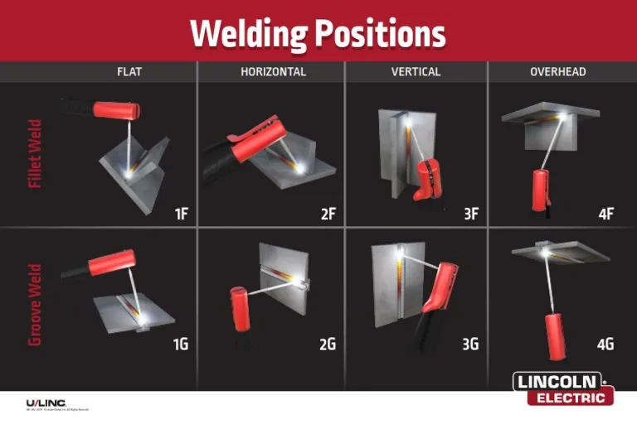

Slide 20
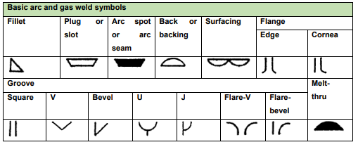
Welding symbols
These symbols provide a standardized way of representing welding processes and instructions on engineering and construction drawings.
They convey essential information to welders and inspectors about the type of weld, its dimensions, and other critical details.

Slide 21
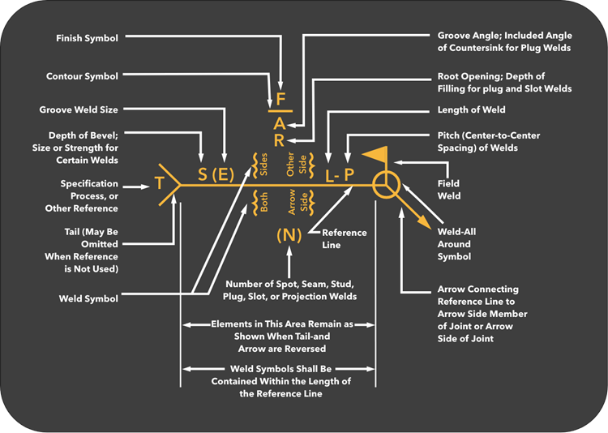
Before we attempt to construct (put together) a welding symbol for a specific joint. We must know where the different elements are placed on the symbol. * On the drawings’ notes, weld size, type of finish, etc. may be written down.

Slide 22
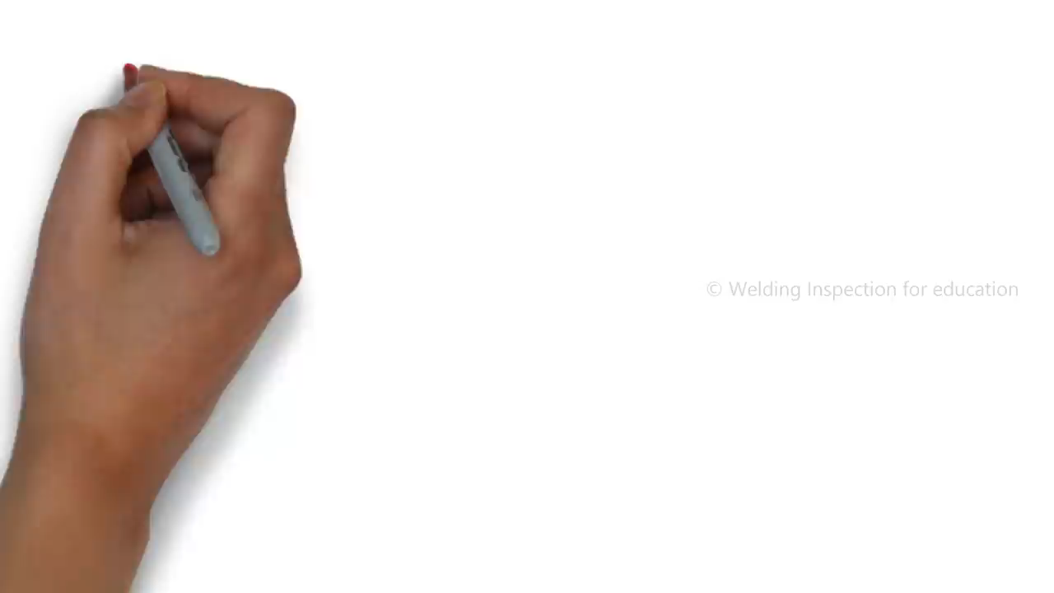
As a welder, you will receive either the side view or the front view welding symbol, not both. It is important to be able interpret the different welding symbols.

Slide 23
Key points
Welding symbols are used to represent welding requirements on engineering drawings.
The text explains different types of butt joints, such as square butt joints, V-butt joints, bevel butt joints, J-butt joints, and U-butt joints.
Welding symbols indicate where the welding should occur (arrow side, other side, or both sides).

Slide 24
Key welding symbols for all welders
the Square Butt Joint
V-Butt Welding Symbol
Bevel butt welding symbol
the J-butt welding symbol
The U-butt joint
Fillet welding symbols
Site weld symbol
Weld all round symbol

Slide 25
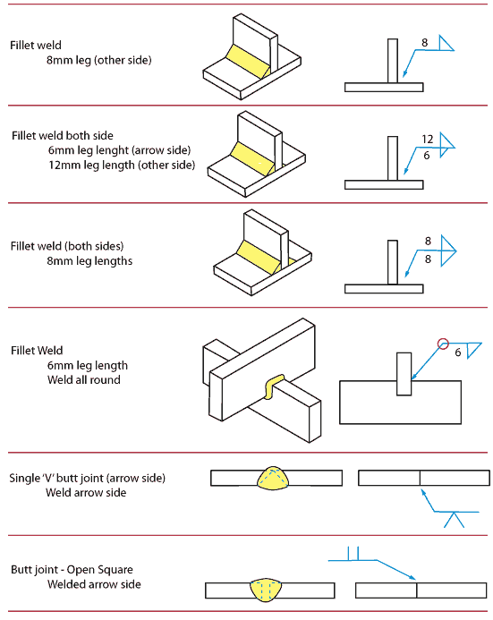
Assessment activity
1. What does the weld symbol “v” stand for?
2. What is known as the reference line?
3.
Discuss the expected welding outcome from the figure.

Slide 26
The effect of welding parameters on performance and their influence on the weld surface
In welding, parameters are vital factors we must consider.
Just tacking and welding metal isn't enough; achieving a quality weld profile requires attention to five key variables:
Current setting,
Arc length,
Angle,
Travel speed, and
Electrode selection.

Slide 27
If these five essentials are not followed nor done even just one of it, there will be some weld discontinuities or defects will occur such as:
Porosities
Overlap
Undercut
Incomplete Fusion
Incomplete penetration
Insufficient throat
Cracks porosity
Insufficient leg size
Excessive convexity
Excessive spatters
Slag inclusions
Poor fusion.

Slide 28
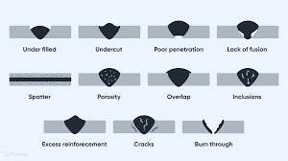
Examples of welding defects

Slide 29
The control of welding parameters
In SMAW (Shielded Metal Arc Welding), weld characteristics like bead size and penetration can be controlled by adjusting several variables:
Electrode size and type.
Amperage (controlled via the welding machine).
Electrode travel speed (the speed at which the electrode moves along the joint).
Arc length (the distance between the metal and the electrode tip, typically equal to the core wire's diameter).
Electrode angle (90 degrees for maximum penetration, 45 degrees for less).
Side-to-side motion of the electrode (affects weld width).

Slide 30
For GTAW (Gas Tungsten Arc Welding), control variables include:
Welding current (DCEN for better penetration and speed, DCEP for rapid electrode tip wear).
Welding voltage (higher voltage for easy arc initiation but wider welds).
Welding speed (affects heat input, faster speed reduces penetration and width).
Heat input (higher heat input results in slower cooling rates).
Shielding gases (argon commonly used for various materials, helium for thick aluminum).
Filler metal (used for plate thickness over 2 mm, selection based on matching parent material).
These control factors impact weld quality, appearance, and performance, and their adjustment depends on the welding process and materials being used.

Slide 31
Visual inspection practices and methods
Visual examination of weld joint is an important activity, carried out to check the integrity and soundness of the weldment.
It is an economic activity, as it doesn’t require any costly equipment.
It must be carried out by a well experienced inspector.
The main responsibilities of a welding inspector are:
Code compliance
Workmanship control
Documentation Control

Slide 32
Visual examination requirements include:
Adequate illumination, with a minimum of 350 Lux recommended, but it's better to have over 500 Lux.
The inspector should be within 600 mm of the item's surface, with a viewing angle of at least 30 degrees.
Additional tools that may be needed for visual inspection:
Welding gauges
Weld gap gauges
Linear misalignment gauges (Hi-Low)
Magnifying glass (X2 to X5)
Mirrored borescope or fiber optic viewing system (for restricted access situations).

Slide 33
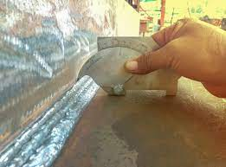
An example of a measuring tool used for visual examination is a Bridge Cam gauge measures
This tool measures various dimensions in inches or millimeters, including:
Angle of Preparation (0° to 60°)
Excess Weld Metal (capping size)
Depth of Undercut
Depth of Pitting
Fillet Weld Throat Size
Fillet Weld Length
Misalignment (High-Low)

Slide 34
Visual inspection occurs at three stages
Before Welding:
During Welding:
After Welding:
The inspector familiarizes themselves with relevant codes, standards, drawings, and welding procedures.
The inspector monitors the welding process and parameters.
An identification number is marked near the joint.
Welder qualification and material confirmation are carried out.
Inspection of welding consumables is performed.
Joint preparation and alignment are checked before welding begins.
Ensures alignment with the welding procedure specification (WPS).
Observes root runs, root run dressing, and interpass temperatures.
Conducts inspections of welding consumables during the welding process.
Comprehensive visual inspection is conducted.
Any surface defects are identified and repaired according to approved procedures.
Possible defects include cracks, underfill, undercut, surface porosity, overlap, lack of side wall fusion, arc strikes, spatters, excessive penetration, and unacceptable weld profiles.

Slide 35
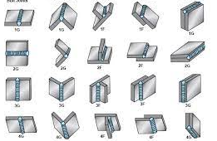
Assessment Activity
Briefly state FIVE most important welding parameters.
List the EIGHT key welding symbols.
List FIVE welding defects.
Explain/define the following welding positions in the figure.

Slide 36

The End

